Slide 1
Ben Culkin
Workplace Readiness Skills
Self Assessment

Slide 2
Personal Qualities and People Skills
Positive Work Ethic
Integrity
Teamwork
Self-Representation
Diversity Awareness
Conflict Resolution
Creativity and Resourcefulness

Slide 3
Positive Work Ethic Pre-Assessment
Comes to work/school everyday on time?
Yes, though I am sometimes a little behind, but never more than 1-2 minutes
Willing to take direction?
Depends on what it is about.
Motivated to accomplish the task at hand?
Not as much as I would like.

Slide 4
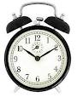

Positive Work Ethic Post-Assessment
Comes to work everyday on time?
Willing to take direction?
Yes. When I come to a fork in the road, I take it. I then ask somebody else which way we should go.
Motivated to accomplish the task at hand?
Can you get any more motivated then this?

Slide 5
Integrity Pre-Assessment
Abides by workplace policy and laws?
99.99% of the time.
Demonstrates honesty and reliability?
As much as is humanely possible.

Slide 6
Integrity Post-Assessment
One day, I found that I had accidentally gotten the key of a quiz we were taking, so I had two choices. Take the key and cheat, or give the key back and have to take a different quiz at another date. I chose to take the quiz again, knowing I probably would have forgotten what was on it by then.

Slide 7
Teamwork Pre-Assessment
Contributes to the success of the team?
Yes. I may not contribute much, but I contribute good things.
Assists others?
Will try to, but I can’t really help with things I am not good at.
Requests help when needed?
I will if I know I need help, but I am more prone to Google than ask someone.

Slide 8
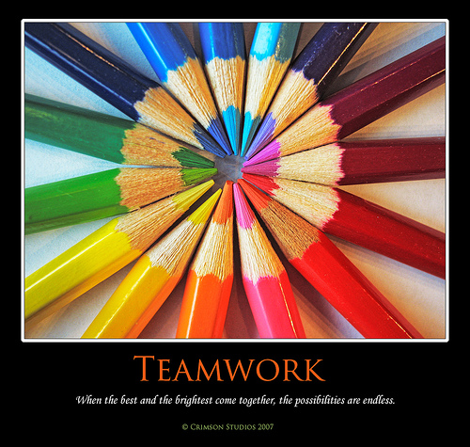
Teamwork Post-Assessment

Slide 9
Self-Representation Pre-Assessment
Dresses appropriately?
Somewhat. I won’t wear inappropriate things, but I am prone to dressing more casual than necessary.
Uses language and manners suitable for the workplace?
I would never think of using foul langauage anywhere except for in my head where no one can hear me.

Slide 10
Self-Representation Post-Assessment
1st place in VWCC region FBLA Contest: Business Procedures
1st place Virginia FBLA Contest: Business Procedures
3rd place National FBLA contest: Business Procedures
CIW Certification

Slide 11
Diversity Awareness Pre-Assessment
Works well with all customers and coworkers?
Certainly tries, but I can be pushed too far.

Slide 12

Diversity Awareness Post-Assessment

Slide 13
Conflict Resolution Pre-Assessment
Negotiates diplomatic solutions to interpersonal and workplace issues?
Not one of my strengths, as I am prone to being as blunt as a punch to the face.

Slide 14
Conflict Resolution Post-Assessment
When I come home, I am the only one who doesn’t persistently profess pernacious problems with my paternal partners, also known as squabbling with my siblings. Therefore, I am the designated peace maker.

Slide 15
Creativity and Resourcefulness Pre-Assessment
Contributes new ideas?
Yes but my ideas are somewhat hard to understand
Works with initiative?
Yes, I can come up with things.

Slide 16

Creativity and Resourcefulness Post-Assessment
Built a Better Mousetrap
Mouse sees cheese
Mouse goes for cheese
Mouse gets cut in half

Slide 17
Professional Knowledge and Skills
Speaking and Listening
Reading and Writing
Critical Thinking and Problem Solving
Health and Safety
Organizations, Systems, and Climates
Lifelong Learning
Job Acquisition and Advancement
Time, Task, and Resource Management
Mathematics
Customer Service

Slide 18
Speaking and Listening Pre-Assessment
Follows directions?
Yes, but I am rather easily distracted
Communicates effectively with customers and fellow employees?
Yes, but as mentioned before, I am rather blunt.

Slide 19
Speaking and Listening Post-Assessment
I am proud to admit that I made it to FBLA Nationals in 9th grade. However, I cannot stress that it required more work then I would have thought necessary, from the studying to the actual taking the test, it was very time intensive, but well worth it.

Slide 20
Reading and Writing Pre-Assessment
Reads and interprets workplace documents?
Yes. I like to read and have a very large vocabulary
Writes clearly?
When I type ;). Unfortunately, my handwriting is terrible, but I am a pretty good writer in content and grammar.

Slide 21
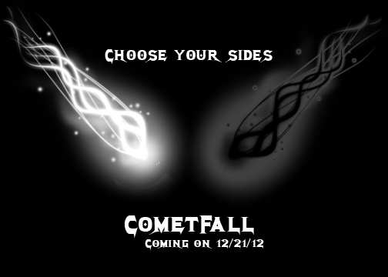


Reading and Writing Post-Assessment
I have the dubious honor of writing ads for a non-existent game, and I think that they came out nicely.

Slide 22
Critical Thinking and Problem Solving Pre-Assessment
Analyzes and resolves problems?
Yes, I love a good puzzle, but I am prone to overcomplicating problems.

Slide 23
Critical Thinking and Problem Solving Post-Assessment
Where λx y.y^2 &λz a.a+4, What will λx z 4 equal?
64, as below
(4+4)^2

Slide 24
Health and Safety Pre-Assessment
Follows safety guidelines?
Yes. I would never willingly endanger myself or someone else through sickness.
Manages personal health?
Somewhat. I am healthy, but a bit unhygienic.

Slide 25
Health and Safety Post-Assessment
My mom is a doctor, so she makes sure we, (we being my family and me) eat healthy. For example, last night was fish & a salad, so I am definitely healthy.

Slide 26
Organizations, Systems, and Climates Pre-Assessment
Identifies “big picture” issues?
Yes, but I can miss some of the details.
Identifies with role in fulfilling the mission of the workplace?
Yes. I just need to know what I must do before I can do it.

Slide 27
Organizations, Systems, and Climates Post-Assessment
I was with my mom, because there was construction going on and she needed some help moving. However, there was one issue, and it was a big picture issue. Literally. She had a picture, and we had to turn it sideways to get it through the door.

Slide 28
Lifelong Learning Pre-Assessment
Continually acquires new industry-related information?
Yes, but I’m am not always sure it is accurate
Improves professional skills?
Yes, because I like doing what I do

Slide 29
Lifelong Learning Post-Assessment
Continually acquires new industry-related information?
Improves professional skills?

Slide 30
Job Acquisition and Advancement Pre-Assessment
Prepares to apply for a job?
I don’t really know, as I have never prepared for a job, but I think I would
Seek promotion?
Yes. The only bad thing about a promotion is the extra work.

Slide 31
Job Acquisition and Advancement Post-Assessment
Prepares to apply for a job?
See promotion?

Slide 32
Time, Task, and Resource Management Pre-Assessment
Organizes and Implements a productive plan of work?
I certainly try, but I find it hard to concentrate at times.

Slide 33
Time, Task, and Resource Management Post-Assessment
Organizes and Implements a productive plan of work?

Slide 34
Mathematics Pre-Assessment
Uses mathematical reasoning to accomplish tasks?
Yes. Programming requires a lot of math, and the ability to apply mathmatics

Slide 35
Mathematics Post-Assessment
Def sqr(λx.x*x)
Def perim(λx y.sqr(x)+sqr(y))
What is perim(λ.1 λ. λ+(λ))
5

Slide 36
Customer Service Pre-Assessment
Identifies and addresses the needs of all customers?
Yes, but a few issues maybe misidentified
Provides helpful, courteous, and knowledgeable service?
Maybe. I have trouble turning down my intelligence for people not as smart as me, so I can be confusing.

Slide 37
Customer Service Post-Assessment
On a early morning, I was standing outside, selling something or other, I forget what it is, and a man came up and started complaining about how he could get the same thing cheaper at some walmart or something nearby, so I resisted the temptation to bite his head off by yelling that these were higher quality, and pointed this out politely.

Slide 38
Technology Knowledge and Skills
Job-Specific Technologies
Information Technology
Internet Use and Security
Telecommunications

Slide 39
Job-Specific Technologies Pre-Assessment
Selects and safely uses technological resources to accomplish work?
Yes, my preferred job is computer based.
Is productive?
Yes, but am rather easily distracted.

Slide 40
Job-Specific Technologies Post-Assessment
I have managed to produce approximately 40 certificates in 7 days, very productive.

Slide 41
Information Technology Pre-Assessment
Uses computers, file management techniques, and software/programs effectively?
Yes. I like to keep my files organized, otherwise I cant find things.

Slide 42
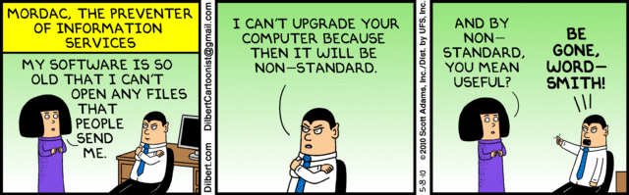
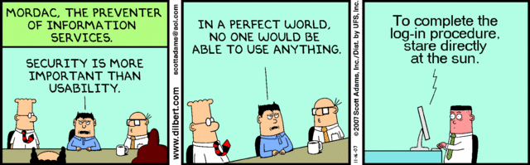
Information Technology Post-Assessment

Slide 43
Internet Use and Security Pre-Assessment
Uses the Internet appropriately for work/school?
Yes, I will not do stuff when I’m supposed to be working.

Slide 44
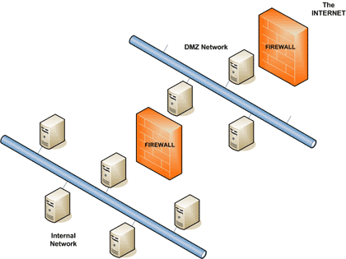
Internet Use and Security Post-Assessment
The Internet
Filter
School

Slide 45
Telecommunications Pre-Assessment
Selects and uses appropriate devices, services, and applications?
Yes. I am very tech – savvy, and like to keep up with the times.

Slide 46
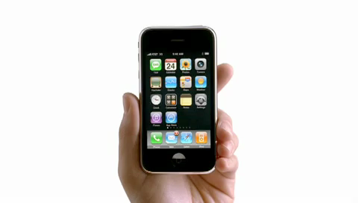
Telecommunications Post-Assessment

Slide 47
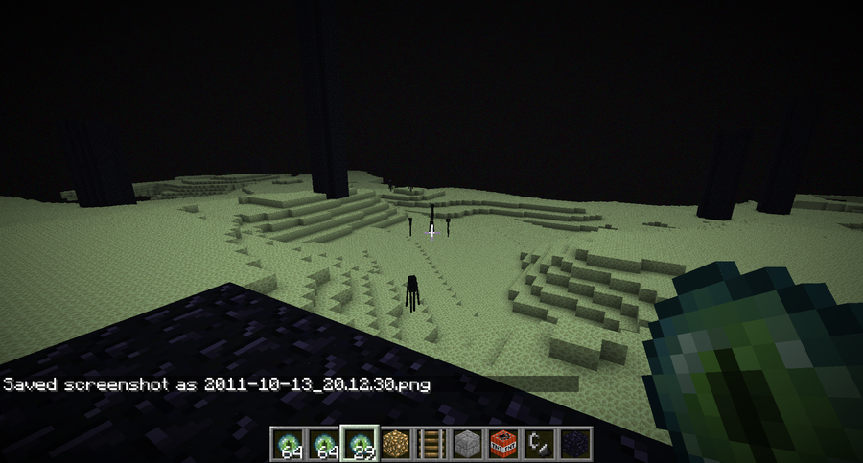
The End
I plan on continuing to improve and grow on my readiness skills, so I guess this is The End

